Slide 1
a SUSE company
Kubernetes Master Class
Recover, Restore and Rebuild:
Disaster Recovery with Rancher and Kubernetes
May 11, 2021

Slide 2
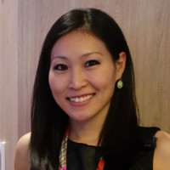
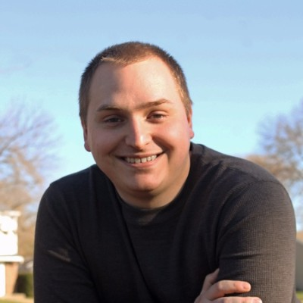

HOST
SPEAKER
Q&A
Connie Lin
Global Events Manager
SUSE
Matt Mattox
Principal Support Engineer
SUSE
Lucas Ramage
Support Engineer
SUSE

Slide 3
Rancher Master Class Series
45 minutes – 75 minutes
Questions are always welcome!
Use the questions tab to submit your questions
We do our best to respond to all questions during the Q&A at the end, so mark your question as private if needed
Notes:
New system – please be patient!

Slide 4
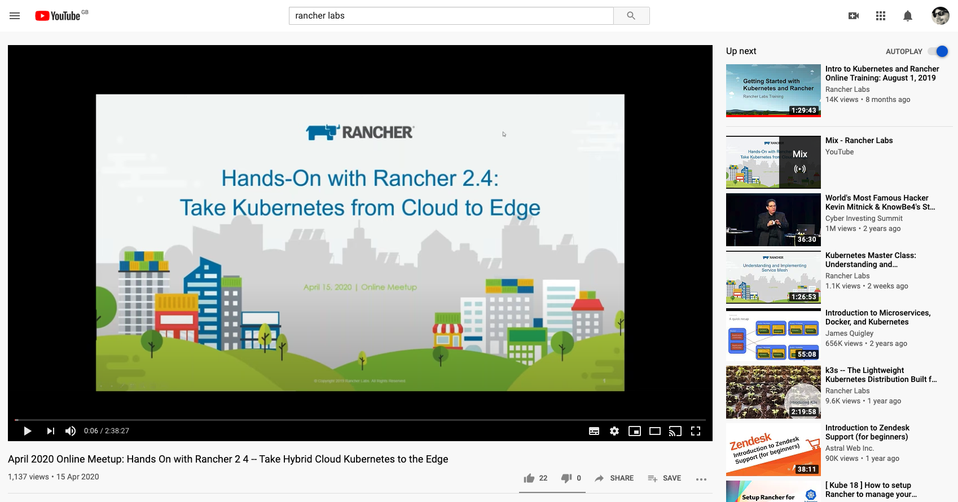
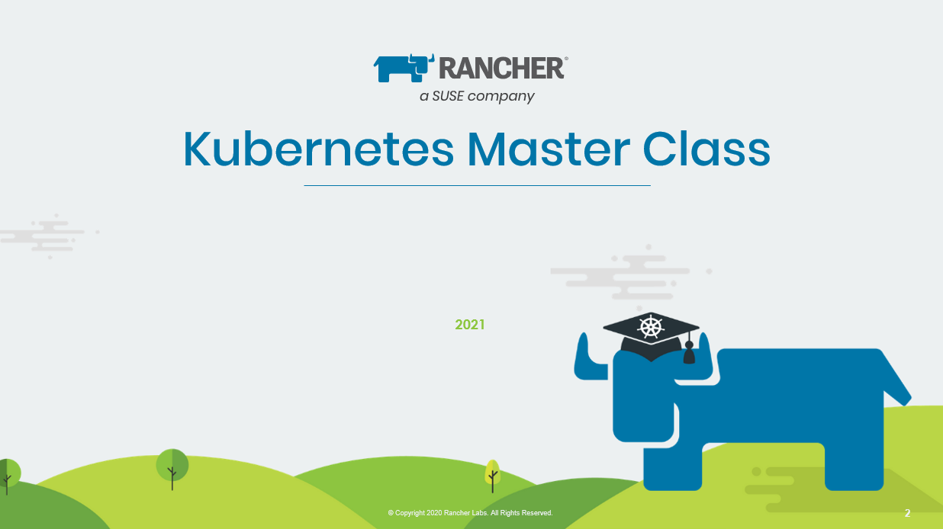
This session is being recorded!
http://youtube.com/c/rancher

Slide 5
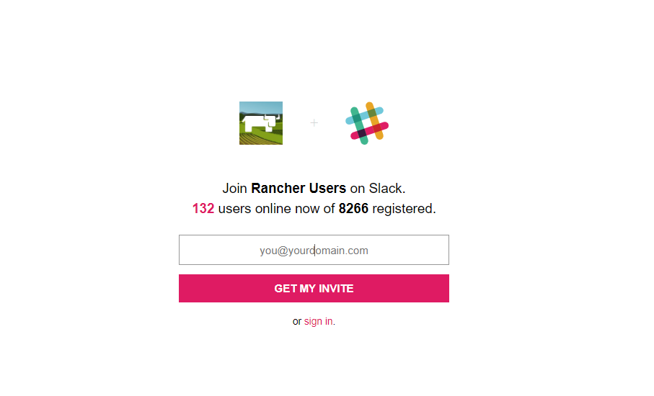
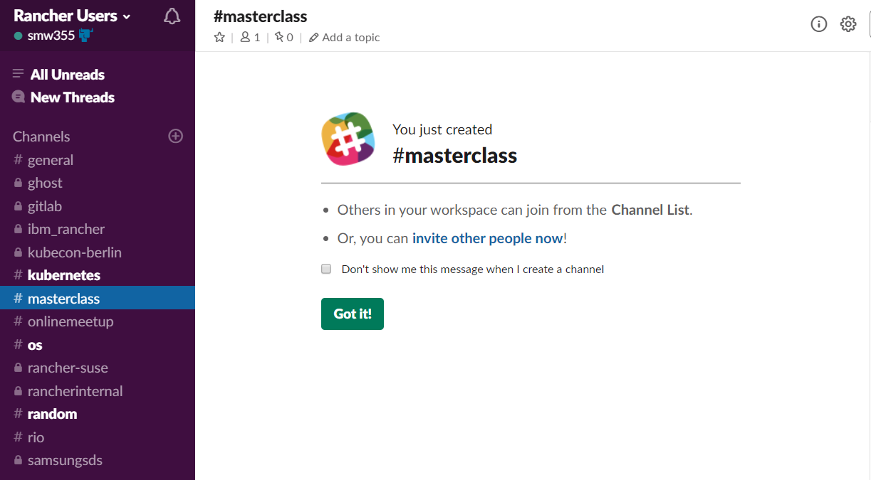
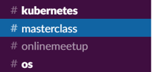
Join the conversation on Slack
https://slack.rancher.io
#masterclass

Slide 6


Introducing the SUSE & Rancher Community
https://community.suse.com
Notes:
We have just launched a new meeting place for the SUSE & Rancher community.
It’s a place where you can develop your knowledge, hands-on skills and networks. Every month, explore a new theme that’s supported by a wide variety of content, including guest speakers, training classes, office hours, and more. Join now and invite your peers, prospects and partners. Check it out at community.suse.com!

Slide 7
a SUSE company
Kubernetes Master Class
Recover, Restore and Rebuild:
Disaster Recovery with Rancher and Kubernetes
May 11, 2021

Slide 8
Overview
Terms
Common scenarios with lab examples
Identifying the issue
Troubleshooting
Restoring/Recovering
Preventive tasks
Reproducing in a lab
Q&A
All scripts, commands, labs, and documentation is located at https://github.com/mattmattox/Kubernetes-Master-Class/tree/main/disaster-recovery/

Slide 9
Terms
Rancher Server is a set of pods that run the main orchestration engine and UI for Rancher.
RKE (Rancher Kubernetes Engine) is the tool Rancher uses to create and manage Kubernetes clusters
Local/upstream cluster This is the cluster where the Rancher server is installed, this is usually an RKE built cluster)
Downstream cluster(s) are Kubernetes cluster that Rancher is managing

Slide 10
Common Scenarios
Recovering from an etcd split-brain
Rebuilding a cluster from scratch
Restoring service after power outage
Pods not being scheduled with OPA Gatekeeper
Run away App stomping all over a cluster
Rotating kube-ca breaks pods
Namespace stuck in terminating

Slide 11
Recovering from an etcd split-brain
What is an etcd split-brain?
Etcd is a leader-based distributed system. Ensure that the leader periodically sends heartbeats on time to all followers to keep the cluster stable. Etcd requires a majority of nodes to up and healthy to accept writes. If the cluster ever lost a quorum, it will go into read-only mode until a quorum is restored.
Reproducing in a lab
https://github.com/mattmattox/Kubernetes-Master-Class/tree/main/disaster-recovery/etcd-split-brain

Slide 12
Rebuilding from etcd backup
When would I need to rebuild from an etcd backup?
Kubernetes uses etcd for storing the all of cluster data including deployments, secrets, configmap, etc. RKE allows us to take an etcd backup and rebuild a cluster using the backup to seed the data inside the cluster. Then is very helpful for disaster situation like a large scale storage outage or accidental deletion for cluster.
Reproducing in a lab
https://github.com/mattmattox/Kubernetes-Master-Class/tree/main/disaster-recovery/rebuild-from-scratch

Slide 13
Restoring service after power outage
What happens to an RKE cluster after a power outage?
RKE/Kubernetes is good about recovering from a cluster shutdown and requires little intervention, though there is a specific order in which things should be powered back on to minimize errors. Etcd is our primary concern because the rest of the services are stateless. Etcd uses a write-ahead log (WAL) to store certain updates before applying them. If a member crashes and restarts between snapshots, it can locally recover transactions done since the last snapshot by looking at the content of the WAL.
NOTE: Etcd uses fdatasync to flush writes from cache to disk.
Reproducing in a lab
https://github.com/mattmattox/Kubernetes-Master-Class/tree/main/disaster-recovery/complete-power-outage

Slide 14
Pods not being scheduled with OPA Gatekeeper
How can OPA Gatekeeper break my cluster?
Gatekeeper uses [validatingwebhookconfigurations](https://kubernetes.io/docs/reference/access-authn-authz/extensible-admission-controllers/) to screen updates request being sent to kube-apiserver to verify they pass Gatekeep's checks. If OPA Gatekeeper is down, these requests will fail, which will break the kube-scheduler because all the update requests will be blocked.
NOTE: OPA Gatekeeper can be set to fail open IE if OPA Gatekeeper is down; assume it would have been approved and move forward.
Reproducing in a lab
https://github.com/mattmattox/Kubernetes-Master-Class/tree/main/disaster-recovery/broken-opa-gatekeeper

Slide 15
Run away App stomping all over a cluster
How can a single app bring down my cluster?
Suppose an application was deployed without CPU and Memory limits. The pod can use so much of a node's resources that the node becomes unresponsive. After 5 mins (default), the kube-scheduler will start rescheduling the pods running on that node to another node. This will, in turn, break that node, and this process will repeat until all nodes are broken.
Reproducing in a lab
https://github.com/mattmattox/Kubernetes-Master-Class/tree/main/disaster-recovery/run-away-app

Slide 16
Rotating kube-ca breaks pods
What is kube-ca, and how can it break my cluster?
Kubernetes uses SSL certificates are all of its services. TLS certificates need certificate authorities' "CAs" work. In this case, kube-ca is a root certificate authority created as part of building the cluster. RKE then creates key pairs for kube-apiserver, etcd, kube-scheduler, etc., and signs them uses kube-ca. This also includes service accounts tokens which are signed by kube-service-account-token. This means that if that chain is broken. kubectl and related services will do the safest option and block the connection.
Reproducing in a lab
https://github.com/mattmattox/Kubernetes-Master-Class/tree/main/disaster-recovery/broken-kube-ca

Slide 17
Namespace stuck in terminating
Why is my namespace stuck in termination?
When you run `kubectl delete ns <namespace>` the namespace object, the `status.phase` will be set to `Terminating,` at which point the kube-controller will wait for the finalizers to be removed. What should happen at this point to the different controllers will detect that they need to clean up their resources inside the namespace. Example: If you delete a namespace that has a PVC inside it. We'll want to call the volume controller to unmap the volume, and at which it will remove the finalizer.
NOTE: finalizers are a safety mechanism built-in Kubernetes to ensure all objects are cleanup before deleting the namespace and should only be removed if the controller is no longer available.
Reproducing in a lab
https://github.com/mattmattox/Kubernetes-Master-Class/tree/main/disaster-recovery/namespace-stuck-terminating

Slide 18
Q & A
https://github.com/mattmattox/Kubernetes-Master-Class/tree/main/disaster-recovery/

Slide 19




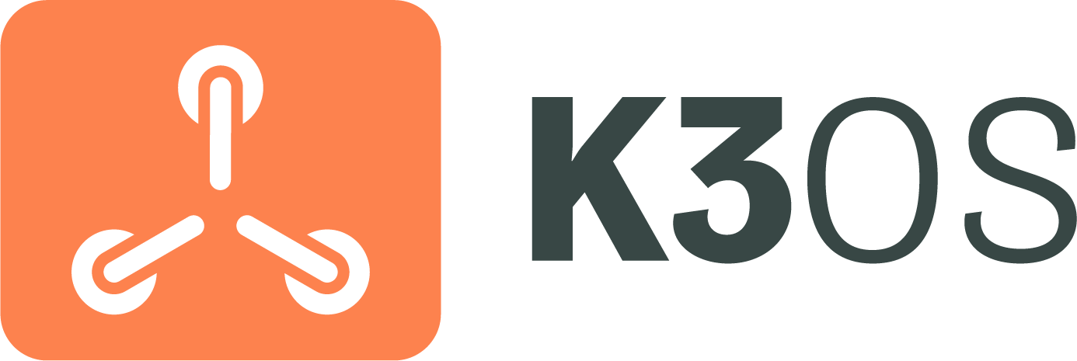



Products & Projects
PRODUCTS
Flagship product - world’s most popular Kubernetes Management platform.
A CNCF-certified Kubernetes distribution that runs entirely within Docker containers.
A CNCF-certified, Lightweight Kubernetes distribution. Easy to install, half the memory, all in a binary less than 100MB.
Makes it faster and easier for DevOps to build, test, deploy, scale and version stateless applications in any K8s cluster.
Purpose-built to simplify Kubernetes operations in low-resource computing environments.
Fleet addresses the challenges of managing thousands to millions of clusters at the network edge.
OPEN SOURCE PROJECTS
Open source project for microservices-based distributed block storage.
Built to connect overlay networks of different Kubernetes clusters.

Slide 20
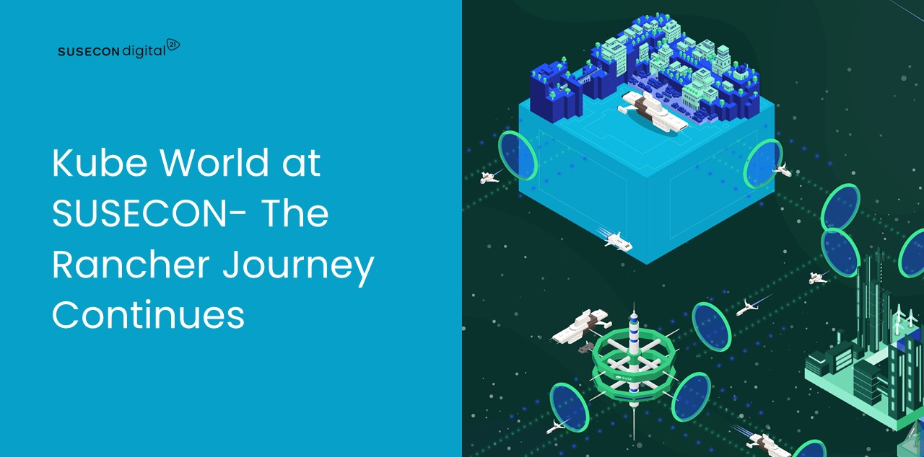
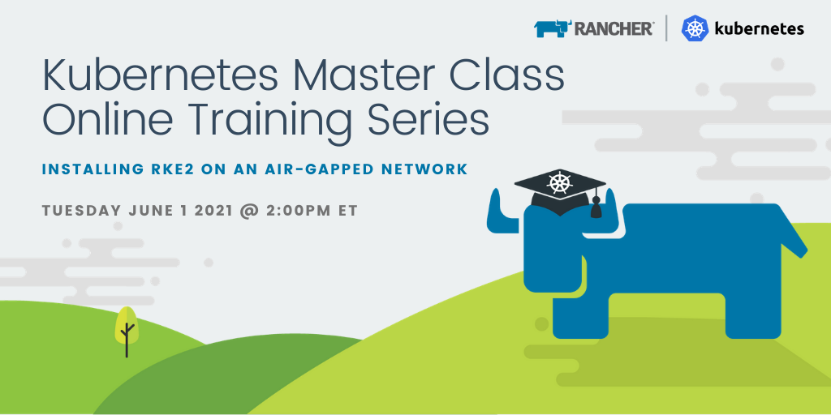
Upcoming Events
Find all upcoming classes & events at rancher.com/events
SUSECON Digital 21
May 18 – 20
https://susecon.com
Kubernetes Master Class
Tuesday June 1 @ 2pm ET
Installing RKE2 on an Air-gapped Network

Slide 21
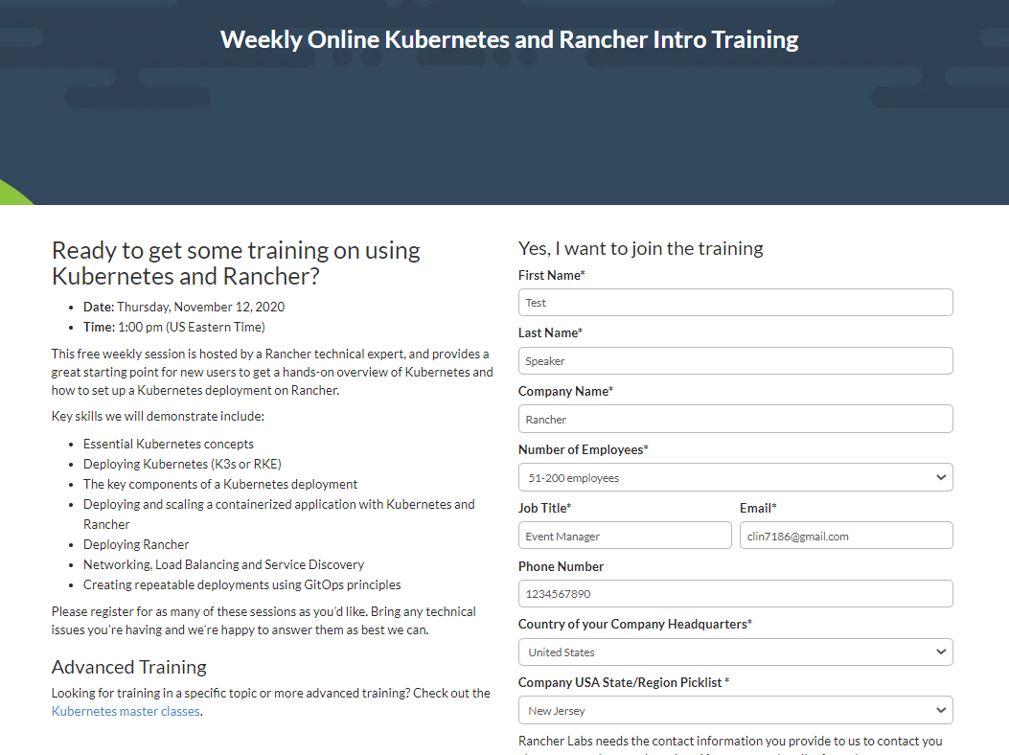
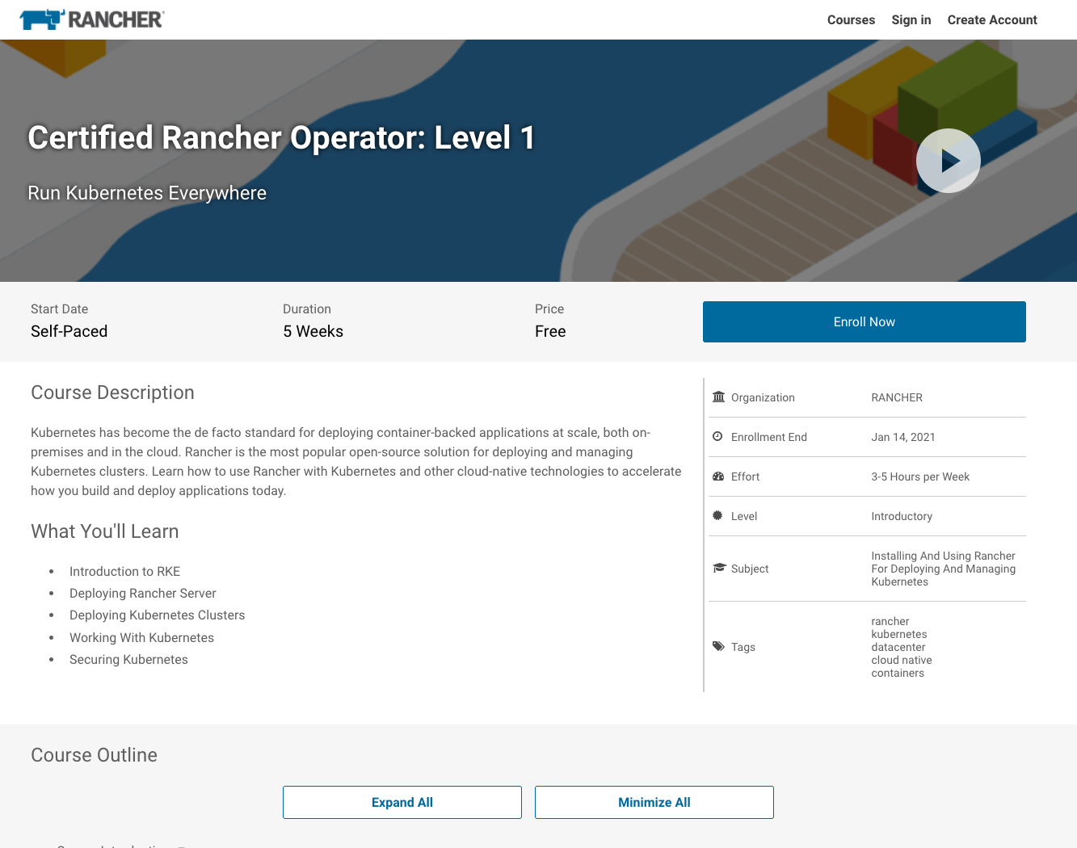
Additional Resources
Intro Training
Get Certified!
https://rancher.com/training
academy.rancher.com

Slide 22
Thank You

